Slide 1
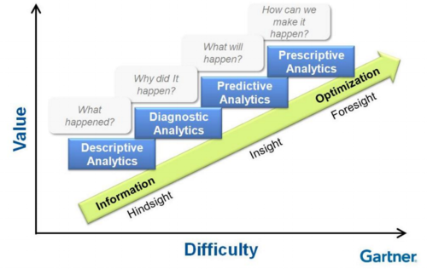
Reporting Outline
01
Reinforcing Ignite’s Principles
04
How Audiences Will Use It
Visibility
Transparency
Awareness
Planning
Scenarios
Brick Toifel follow-up
Anne Marie status update
Internal analysis to establish a “reasonable” SLA
Internal analysis to understand product families
02
Questions We Can Now Answer
05
Solution Components
“Where’s my stuff?”
“Why did it take so long?”
“What SLA can I expect?” (eventually)
“How can we focus improvements efforts?”
Any Limitations for cycle # 1 (with work-arounds)
Ariba with MS Excel file exports
Tableau
Some manual intervention (cycle # 1)
03
Output – What it looks like
06
Roadmap – Where we go next
Example of what the report will actually look like
Be careful not to “beautify” it, unless that’s what we plan to do in production
Focus on “substance” over “style”
Correct/fix limitations
Future vision
More self-service
More management-level reports
Natural progression:

